Slide 1
BUILDING A COMPUTER LABORATORY
A preferrebly rectangular room is chosen to be used as a computer laboratory.

Slide 2
1.Assemble and arrange the furniture
(Evaluate furniture and options)
After identifying your rectangular room,assemble all the furniture to be used in the room and their arrangement in space you decided while planning. Arrange the seven desks in a raw facing the length of the building, place chairs which are adjustable to face the desks.

Slide 3
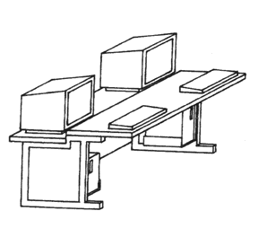

Slide 4
2. Set up the computers and the conditioning/AC(PowerPoint)
The seven computers are then arranged systematically on top of the desk. All the computer out put devices mice, monitors and keyboards attached. Later the computers are plugged into functioning sockets. Boot up the computers and confirm that the plugged power sockets and the cables are in good condition and configured in the right manner.

Slide 5
3. Network the computers together
Computer networking enhances access and information sharing on any computer connected to the same network. It proves crucial incase of damage or theft of owners original computer, not forgetting printers, media center servers, video games can be easily accessed from any computer connected to the same network.

Slide 6
4. Prevent Trip Harzards
The use of certified floor card covers help minimize the risks of users tripping as opposed to exposed cables as the provide safe walking surface on top of being water resistant. They are cheap and with ease in installation. Vector tiles are then used to assemble cables hence creating a clear pathway.
NB: Cables clip are excellent in preventing un necessary hazard.

Slide 7
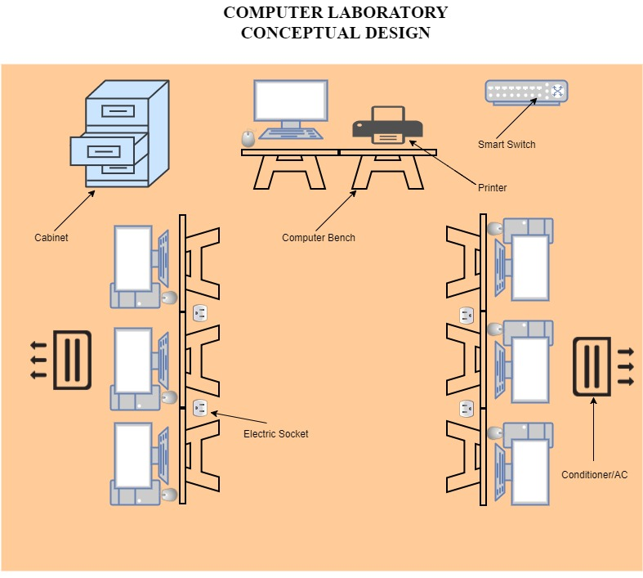
COMPUTER LAB. CONCEPUTAL DESIGN

Slide 8
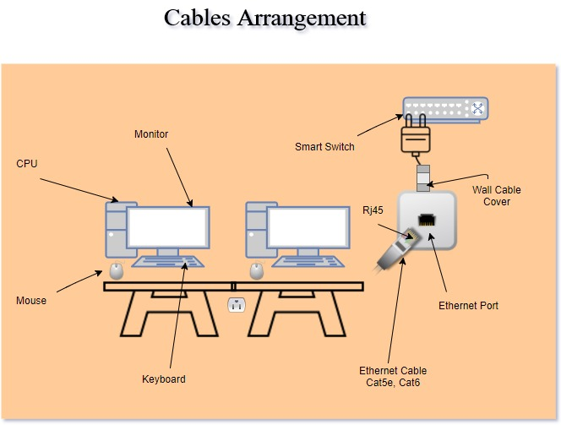
Cables arrangement IN A COMPUTRE LABORATORY

